Slide 1
A Solution Approach to Valuation With Unhedgeable Risks
- A review of Thaleia (2001)
Ao Shen (as11884@nyu.edu)
Yangyi Zheng (yz8838@nyu.edu)
‹#›
Notes:
‹#›

Slide 2
Outline
The original paper
Supplementary material
Indifference of utility for models with stochastic volatility
Simulation
Conclusion
References
‹#›

Slide 3
Core Idea
Stochastic optimization models of expected utility
Prices are modelled as diffusion processes with correlated diffusion factors
Reduced form solutions
Power transformation
Value function
The solution of a linear parabolic equation
Power exponent depending only on the co-efﬁcients of correlation and risk aversion

Slide 4
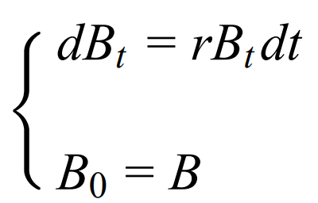
Walk Through (1)
The investment model
a bond and a stock market
Price of the bond Bt
where r > 0 is the interest rate
Price of the stock St
with S0 = S ≥ 0 and Yt as the “stochastic factor”

Slide 5
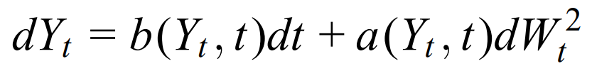

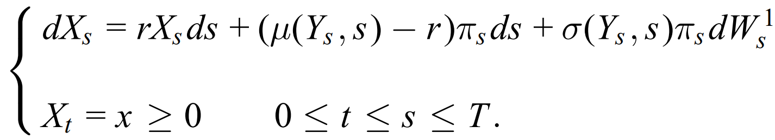
Walk Through (2)
Stochastic factor Yt
for Y0 = y ∈ R
W1t and W2t are Brownian Motions correlated with correlation coefficient ρ with −1 ≤ ρ ≤ 1
Rebalance portfolio dynamically at any time s for s ∈ [t, T] and 0 ≤ t ≤ T
(bond + stock market)

Slide 6

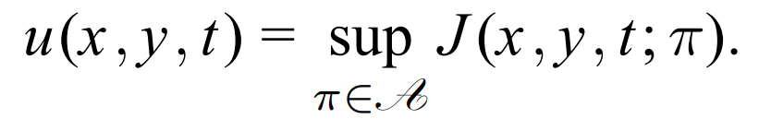

Walk Through (3)
Wealth process must also satisfy the state constraint
Objective: maximize his expected utility of terminal wealth
The value function of the investor is
The utility function is of the separable CRRA type
h : R → R+ being a bounded continuous function

Slide 7
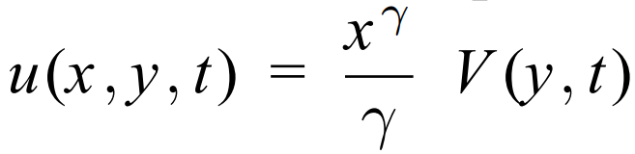
Walk Through (4)
Rewrite the value function by homogeneity
V solves a nonlinear equation for which no closed form solutions are available
Novelty!
Simple transformation that removes certain non-linearities that arise due to the stochastic factor
V can be expressed as the power of the solution of a linear parabolic equation
Reduction from the original fully nonlinear Hamilton-Jacobi-Bellman equation

Slide 8
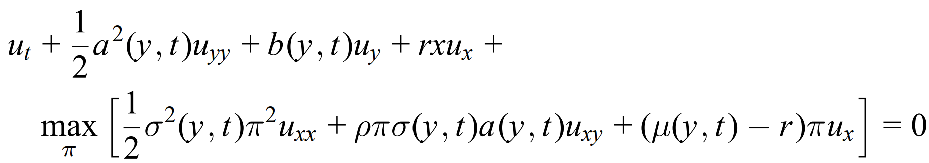

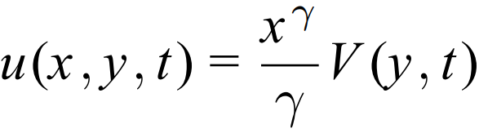
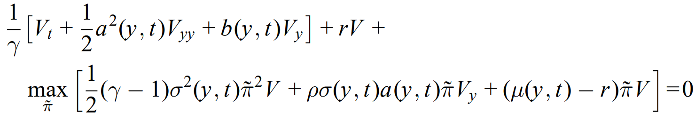
Walk Through (5)
The HJB equation
Terminal condition：
Substitute into HJB

Slide 9
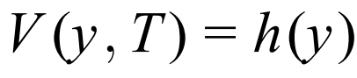
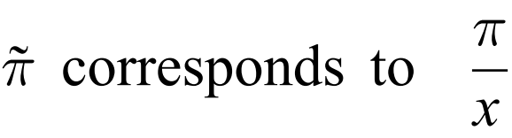
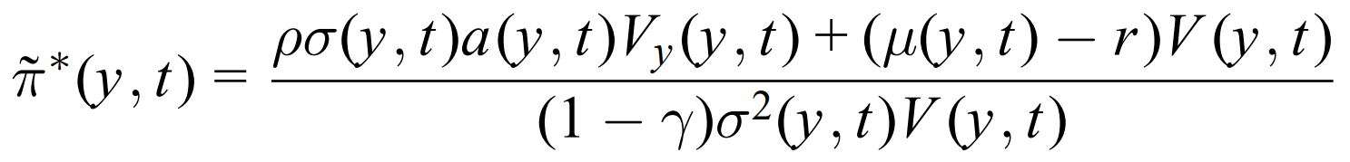
Walk Through (6)
Terminal condition
FOC: Max is achieved at

Slide 10
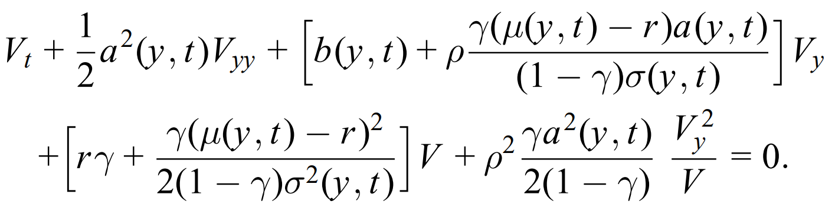

Walk Through (7)
Plug back into HJB
Expand
Let then

Slide 11
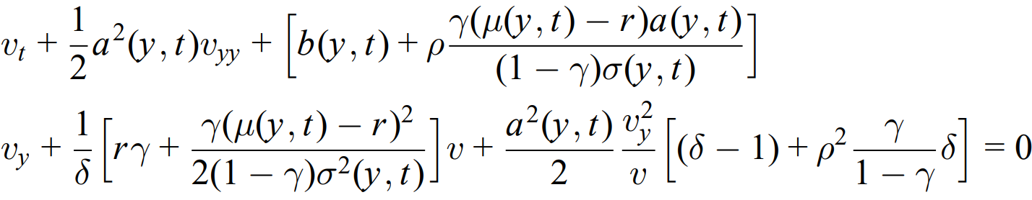
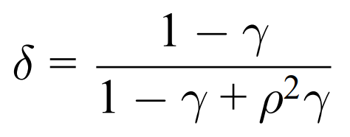
Walk Through (8)
Substitute
If we choose the parameter δ to satisfy
Then it becomes a linear parabolic differential equation

Slide 12
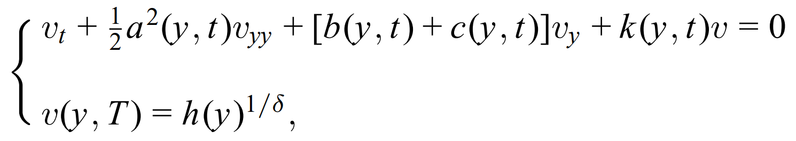
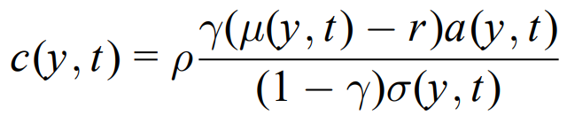
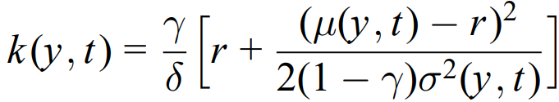
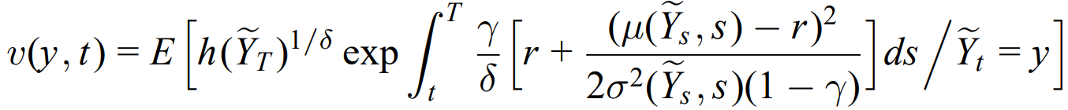
Walk Through (9)
We have
where &
δ is the distortion power
By Feynman-Kac
with

Slide 13
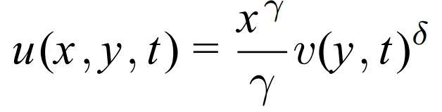
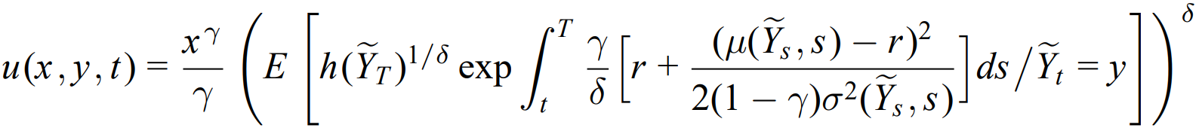
Walk Through (10)
Therefore, we see that the value function u is represented as
Or
where
and

Slide 14
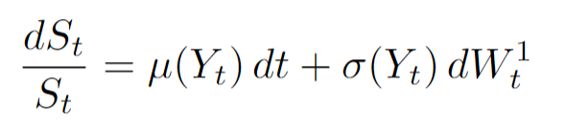
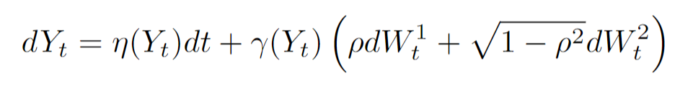

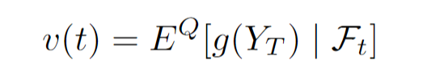
Utility Indifference Pricing with Stochastic Factor
Risky asset defined as below
Stochastic Factor defined as
Consider the European Option payoff
The traditional risk neutral pricing formula will not work in this case
We introduced additional Stochastic factor here. The market is not complete; the risk neutral measure is not unique in this case.
In BS framework, we make the discounted stock price to be martingale under risk neutral measure

Slide 15
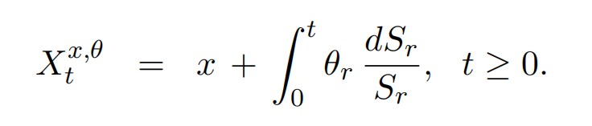
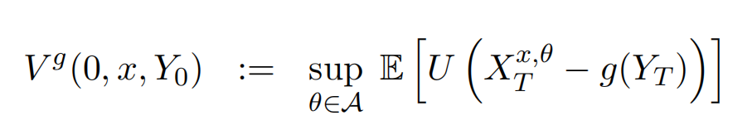

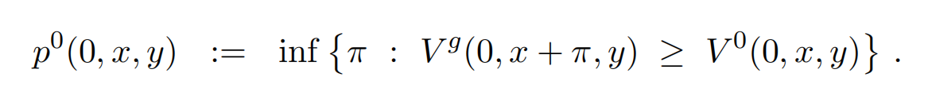
Utility Indifference Pricing with Stochastic Factor
The portfolio process with initial capital x investing in risky asset and zero interest rate is
We define the optimal investment problem with option G as below
With Utility function defined as
The price of the option will be given by

Slide 16
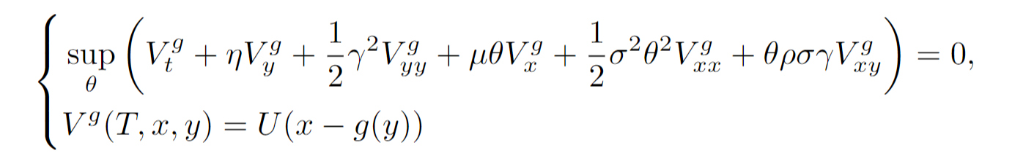
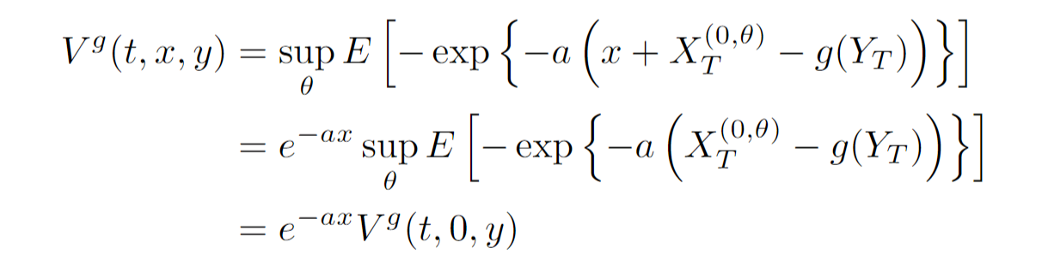

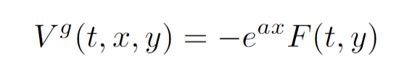
HJB equation of the optimal investment with option
For HJB of the V(t, x, y), since it has extra dimension. It will have extra terms for y and cross terms.
We can see that (homogeneity)
Define , Then s s Substitute F back into the HJB equation

Slide 17
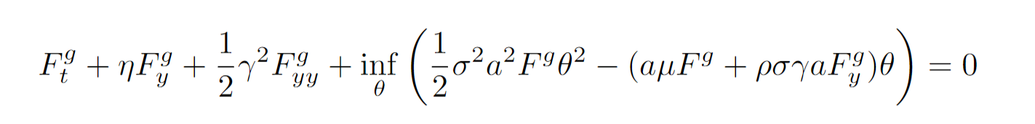
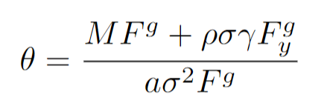
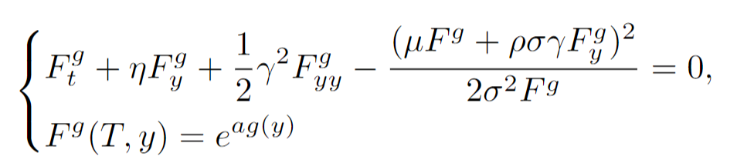
HJB equation of the optimal investment with option
Simplify, we can get
Therefore, we can get the optimal investment policy
The HJB equation turns into
It is a nonlinear PDE; Apply the power transformation technique proposed by the paper.

Slide 18
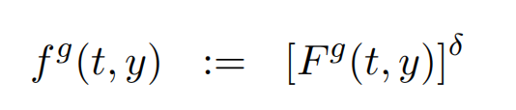
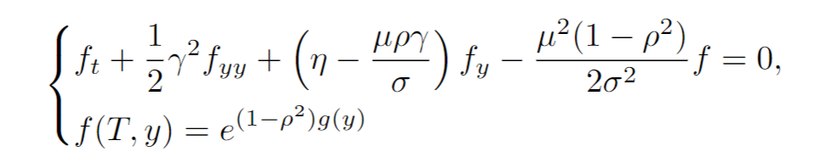

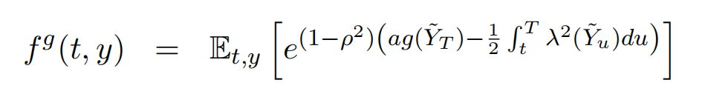
Power transformation
Using
Nonlinear PDE can be reduced into linear parabolic PDE
With
By Feymann-Kac:

Slide 19
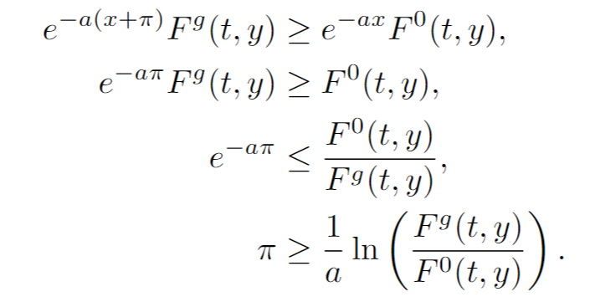
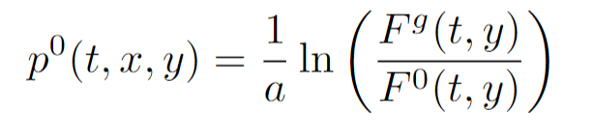
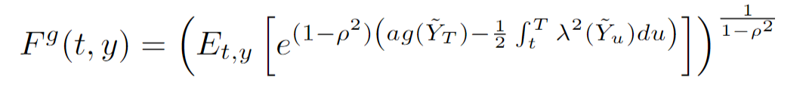
Utility Indifference Pricing
Now we can derive the formula for price
For every 𝝅 in the set, it will satisfy the following
The infinum will be achieved at equality, therefore, the price will be
where

Slide 20
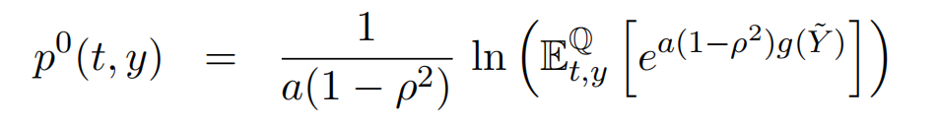
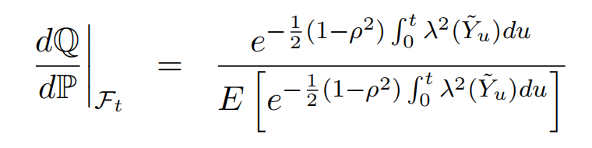
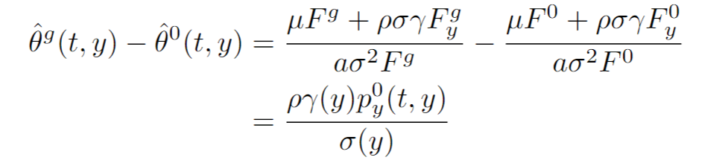
Utility Pricing with hedging
Price can be further simplified into the form
where
For hedging amounts in stock, it can be computed by the difference between the amount invested in the stock of portfolio with option and portfolio without option

Slide 21
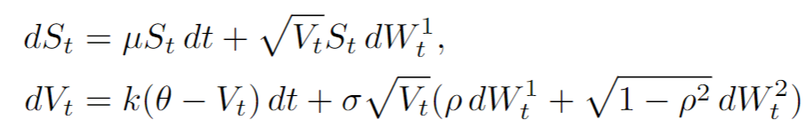

Specific Example of Heston Model
We have to specify the specific dynamics of asset price and stochastic factor
The relation to the general setting is
The option we are specifying is the traditional European call option.
We are interested in the pricing and hedging result under heston model by using the utility pricing method

Slide 22
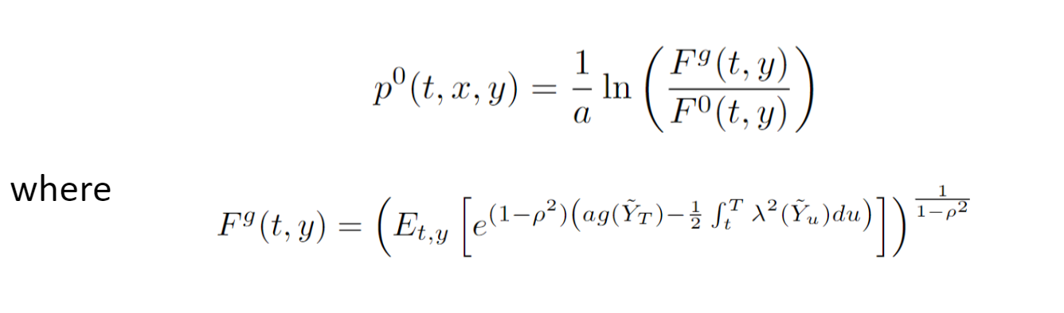
Simulation Steps
For simulation of prices, we will use
Simulate two series of independent standard normal distributions times the step size.
Simulate stock price and variance process with modified drift based on the dynamics. The simulation of variance under the CIR process could be negative.
Use Monte Carlo to get the value of expectation
Calculate option price
Repeat above steps N times to get the distribution of the price

Slide 23
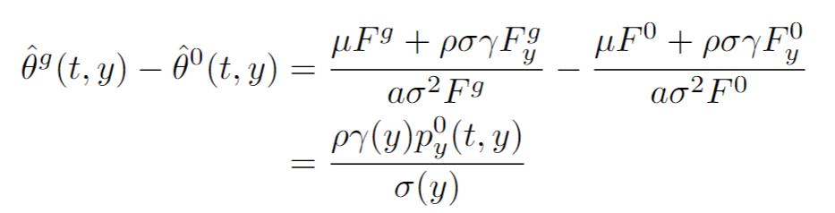
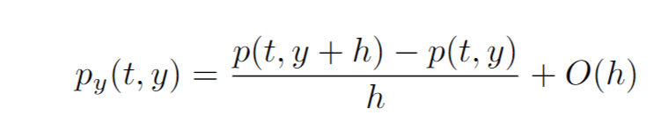
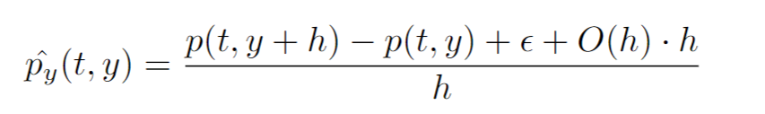
Simulation Steps
Once get the result of the price, we can compute the hedging amounts in stock
To compute the derivative, using forward difference
The result is bad – the hedging amounts in stocks is big and the direction is unstable.
Error term seems to dominate in the computation of derivative
What are in the error term?
Forward Euler, Integration(Simpson's rule), standard error in Monte Carlo …
Small stepsizes and More simulations will make it better?

Slide 24
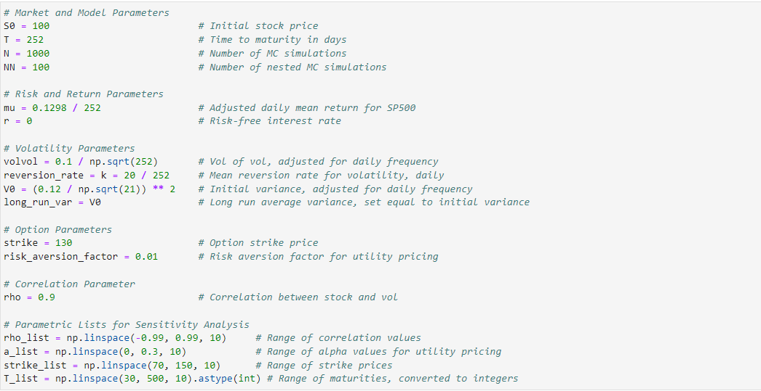
Simulation

Slide 25
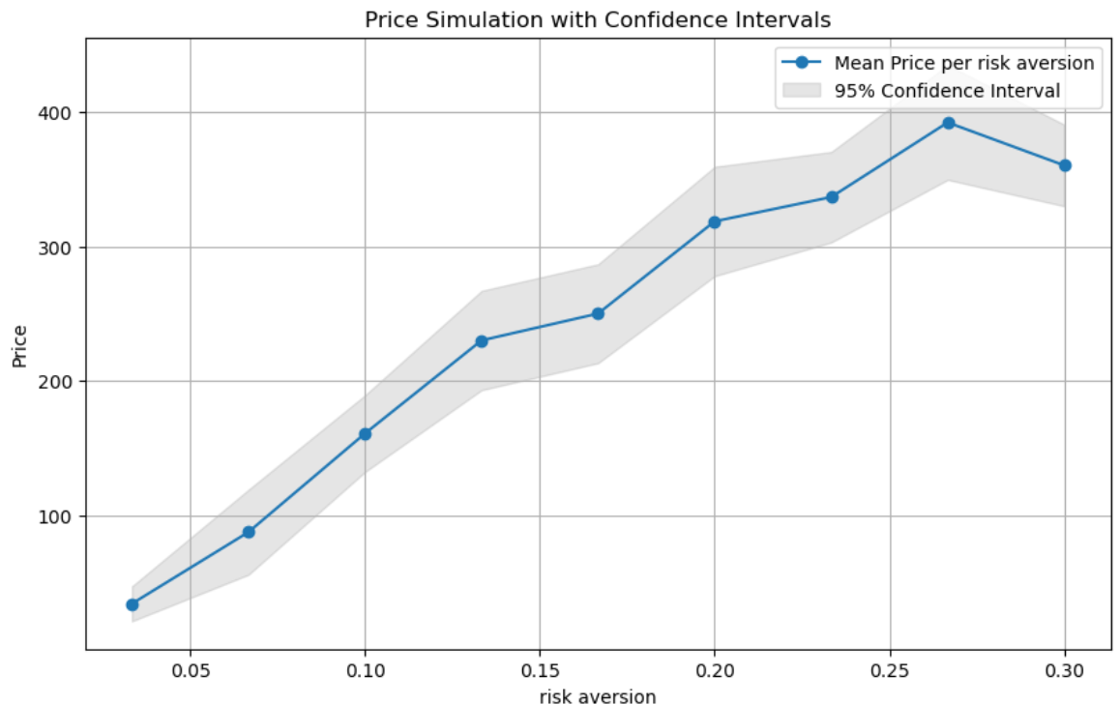
Simulation

Slide 26
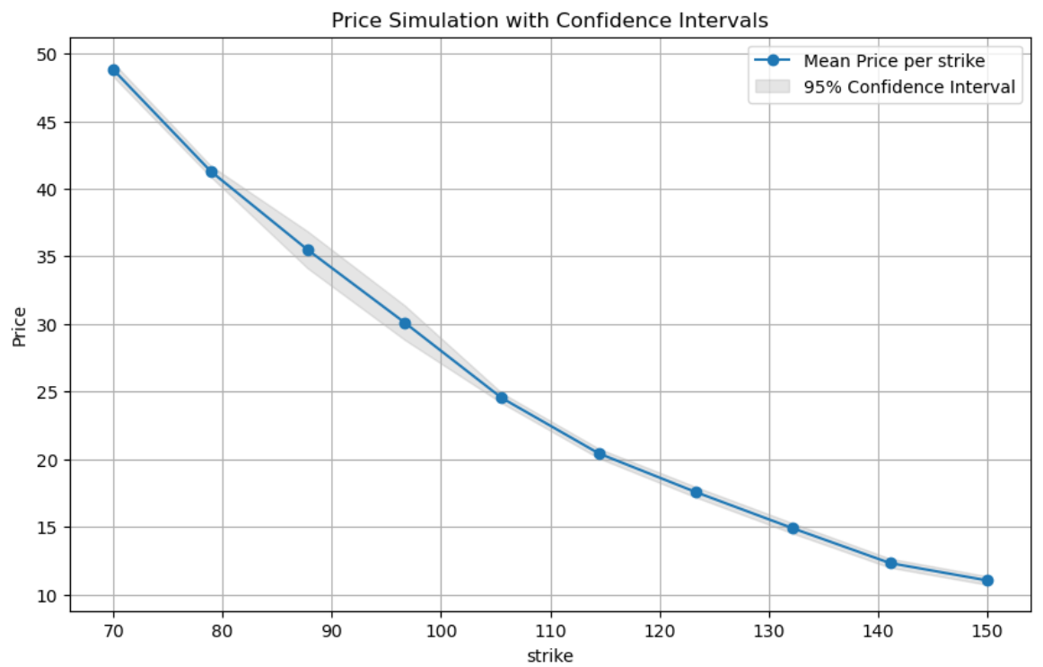
Simulation

Slide 27
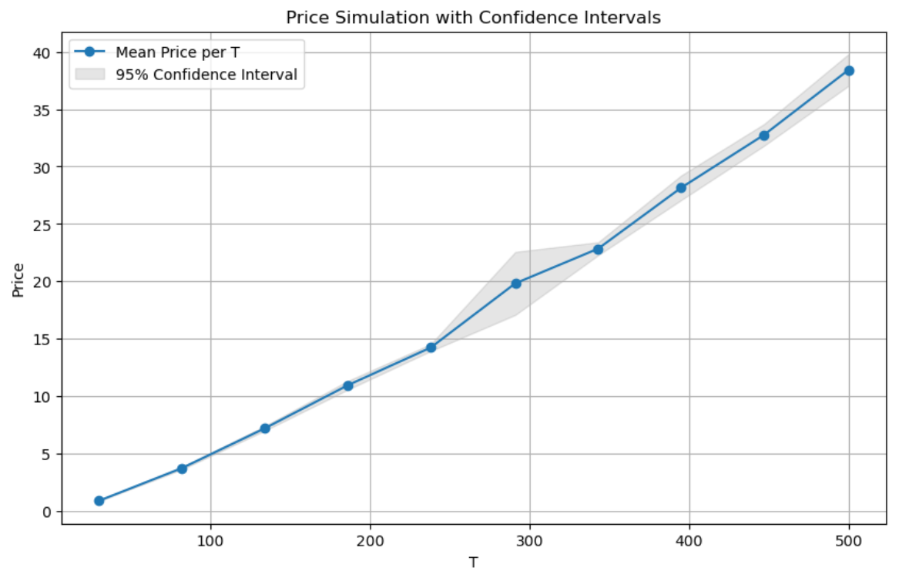
Simulation

Slide 28

Simulation

Slide 29
Conclusion
Paper
Great idea
Not clear in the examples section
xxx
xxx
Applications in paper
Utility pricing
Simulation
Prices go up when
ρ -> 0
a -> 1
Strike decreases
T increases
hard to compute hedging portfolio(errors)

Slide 30
References
Zariphopoulou, Thaleia. (2001). A Solution Approach to Valuation With Unhedgeable Risks. Finance and Stochastics. 5. 61-82. 10.1007/PL00000040.

